Slide 1
Search via Quantum Walk
Sharan Krishnan

Slide 2
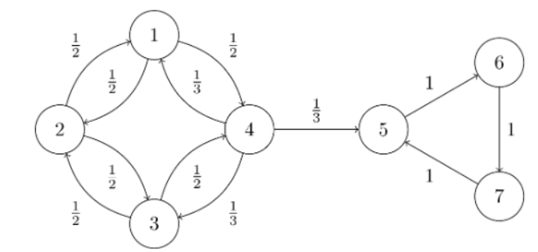


Background: Markov Chains
A Markov chain, denoted $(X_{n})$ is an ordered sequence of samples from a discrete state space $S$, ordered by a discrete time index $n$. Markov chains satisfy the Markov property:
$$P\left(X_{n+1} | X_{n},X_{n−1}…\right)=P(X_{n+1}|X_{n})$$
A time-homogenous Markov chain is one where $P(X_{n+1}|X_{n})$ is independent of time $n$. When the state space is finite, these are best represented as graphs.

Slide 3
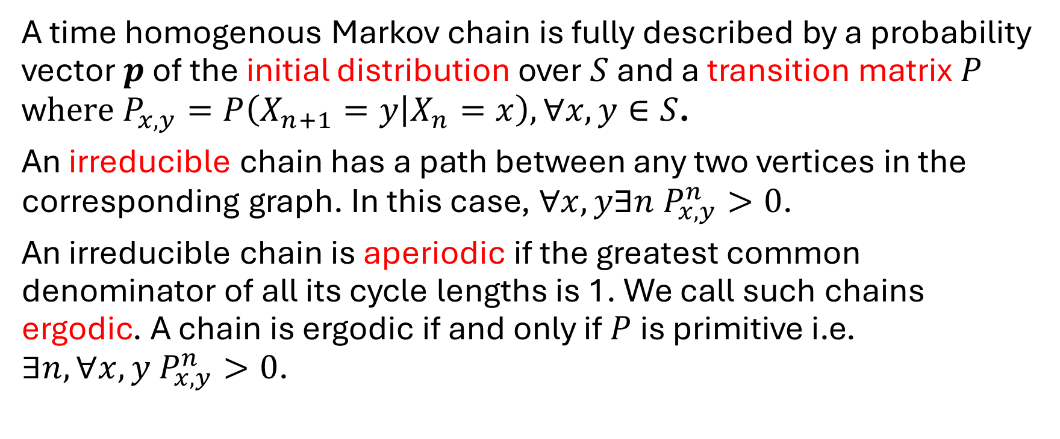
Background: Irreducible and Aperiodic Chains
A time homogenous Markov chain is fully described by a probability vector $p$ of the initial distribution over $S$ and a transition matrix $P$ w$here P_{x,y}=P\left(X_{n+1}=y | X_{n}=x\right),∀x,y∈S$.
An irreducible chain has a path between any two vertices in the corresponding graph. In this case, $∀x,y∃n P_{x,y}^{n}>0$.
An irreducible chain is aperiodic if the greatest common denominator of all its cycle lengths is 1. We call such chains ergodic. A chain is ergodic if and only if $P$ is primitive i.e. $∃n,∀x,y P_{x,y}^{n}>0$.

Slide 4
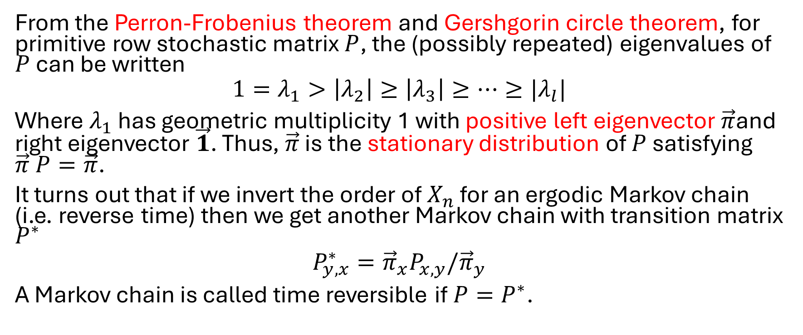
Background: Stationary Distributions and Time Reversible Markov Chains
From the Perron-Frobenius theorem and Gershgorin circle theorem, for primitive row stochastic matrix $P$, the (possibly repeated) eigenvalues of $P$ can be written
$$1=λ_{1}>\left|λ_{2}\right|≥\left|λ_{3}\right|≥…≥|λ_{l}|$$
Where $λ_{1}$ has geometric multiplicity 1 with positive left eigenvector$\vec{π}$and right eigenvector $\vec{1}$. Thus, $\vec{π}$ is the stationary distribution of $P$ satisfying $\vec{π} P=\vec{π}$.
It turns out that if we invert the order of $X_{n}$ for an ergodic Markov chain (i.e. reverse time) then we get another Markov chain with transition matrix $P^{∗}$
$$P_{y,x}^{∗}={\vec{π}}_{x}P_{x,y}/{\vec{π}}_{y}$$
A Markov chain is called time reversible if $P=P^{∗}$.

Slide 5
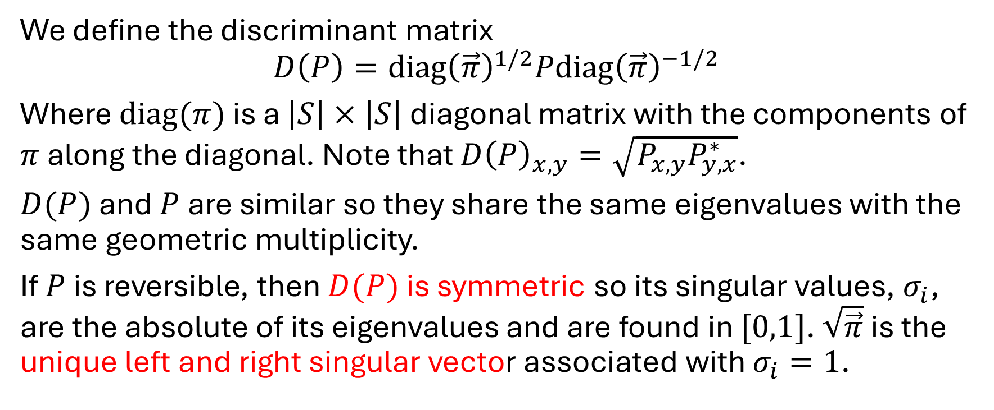
Background: Discriminant Matrix
We define the discriminant matrix
$$D\left(P\right)=diag{\left(\vec{π}\right)}^{1/2}Pdiag{\left(\vec{π}\right)}^{−1/2}$$
Where $diag(π)$ is a $\left|S\right|×\left|S\right|$ diagonal matrix with the components of $π$ along the diagonal. Note that $D{\left(P\right)}_{x,y}=\sqrt{P_{x,y}P_{y,x}^{∗}}$.
$D(P)$ and $P$ are similar so they share the same eigenvalues with the same geometric multiplicity.
If $P$ is reversible, then $D(P)$ is symmetric so its singular values, $σ_{i}$, are the absolute of its eigenvalues and are found in $[0,1]$. $\sqrt{\vec{π}}$ is the unique left and right singular vector associated with $σ_{i}=1$.

Slide 6
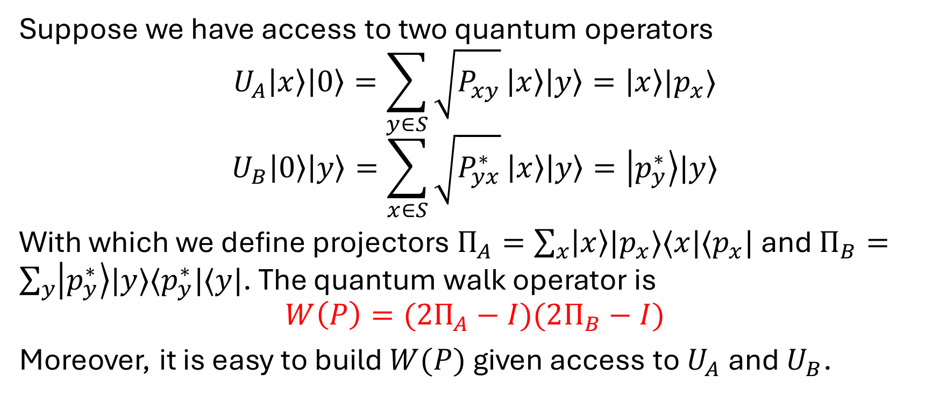
Szegedy’s quantum walk operator I
Suppose we have access to two quantum operators
$$U_{A}\left|x\right\rangle \left|0\right\rangle =\sum_{y∈S}{\sqrt{P_{xy}}}\left|x\right\rangle \left|y\right\rangle =\left|x\right\rangle |p_{x}⟩$$
$$U_{B}\left|0\right\rangle \left|y\right\rangle =\sum_{x∈S}{\sqrt{P_{yx}^{∗}}}\left|x\right\rangle \left|y\right\rangle =\left|p_{y}^{∗}\right\rangle |y⟩$$
With which we define projectors $Π_{A}=\sum_{x}{\left|x\right\rangle |p_{x}⟩⟨x|⟨p_{x}|}$ and $Π_{B}=\sum_{y}{\left|p_{y}^{∗}\right\rangle |y⟩⟨p_{y}^{∗}|⟨y|}$. The quantum walk operator is
$$W\left(P\right)=(2Π_{A}−I)(2Π_{B}−I)$$
Moreover, it is easy to build $W(P)$ given access to $U_{A}$ and $U_{B}$.

Slide 7
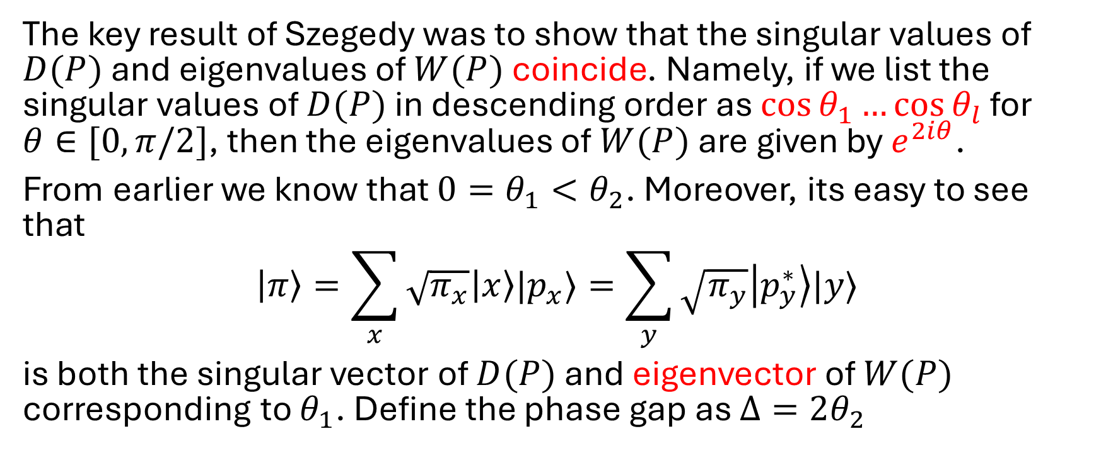
Szegedy’s quantum walk operator II
The key result of Szegedy was to show that the singular values of $D(P)$ and eigenvalues of $W(P)$ coincide. Namely, if we list the singular values of $D(P)$ in descending order as $\cos{θ_{1}}…\cos{θ_{l}}$ for $θ∈[0,π/2]$, then the eigenvalues of $W(P)$ are given by $e^{2iθ}$.
From earlier we know that $0=θ_{1}<θ_{2}$. Moreover, its easy to see that
$$\left|π\right\rangle =\sum_{x}{\sqrt{π_{x}}\left|x\right\rangle |p_{x}⟩}=\sum_{y}{\sqrt{π_{y}}\left|p_{y}^{∗}\right\rangle |y⟩}$$
is both the singular vector of $D(P)$ and eigenvector of $W(P)$ corresponding to $θ_{1}$. Define the phase gap as $Δ=2θ_{2}$

Slide 8
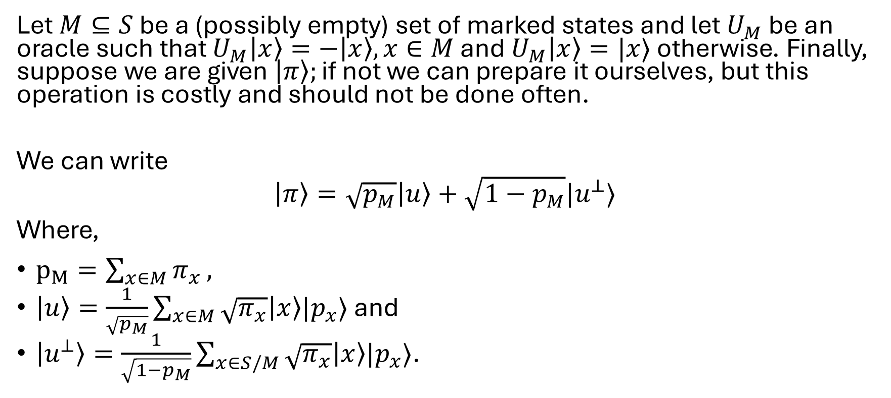
High level search algorithm I
Let $M⊆S$ be a (possibly empty) set of marked states and let $U_{M}$ be an oracle such that $U_{M}\left|x\right\rangle =−\left|x\right\rangle , x∈M$ and $U_{M}\left|x\right\rangle =|x⟩$ otherwise. Finally, suppose we are given $\left|π\right\rangle ;\text{if} \text{not} \text{we} \text{can} \text{prepare} \text{it} \text{ourselves}\text{, }\text{but} \text{this} \text{operation} \text{is} \text{costly} \text{and} \text{should} \text{not} \text{be} \text{done} \text{often}\text{.}$
We can write
$$\left|π\right\rangle =\sqrt{p_{M}}\left|u\right\rangle +\sqrt{1−p_{M}}|u^{⊥}⟩$$
Where,
$p_{M}=\sum_{x∈M}{π_{x}},$
$\left|u\right\rangle =\frac{1}{\sqrt{p_{M}}}\sum_{x∈M}{\sqrt{π_{x}}\left|x\right\rangle |p_{x}⟩}$ and
$\left|u^{⊥}\right\rangle =\frac{1}{\sqrt{1−p_{M}}}\sum_{x∈S/M}{\sqrt{π_{x}}\left|x\right\rangle |p_{x}⟩}$.

Slide 9
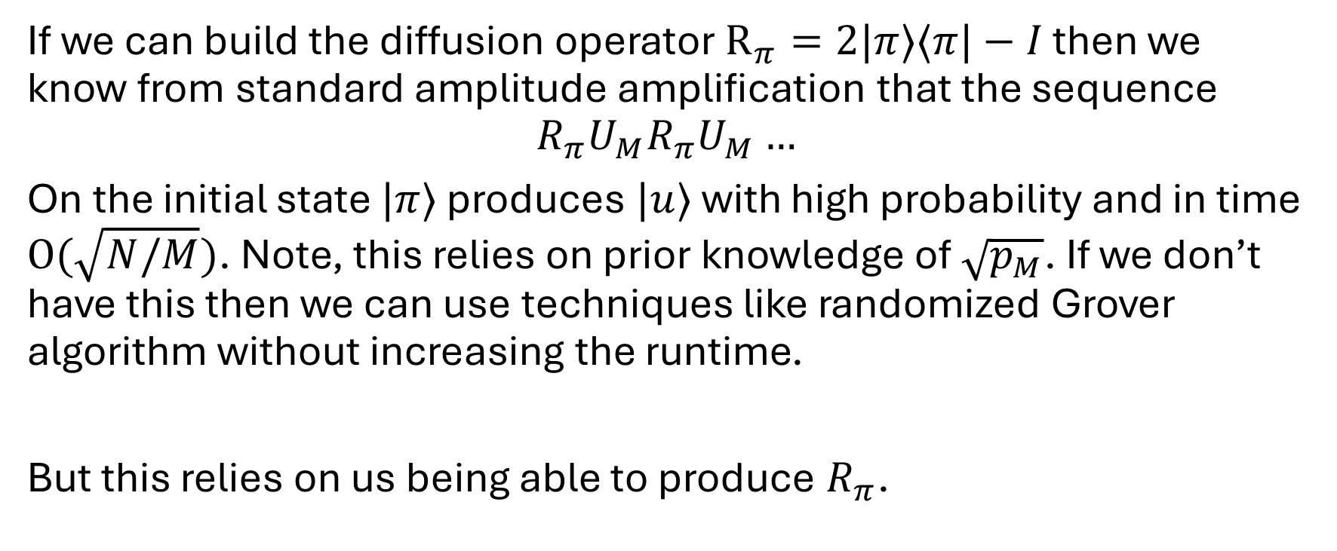
High level search algorithm II
If we can build the diffusion operator $R_{π}=2|π⟩⟨π|−I$ then we know from standard amplitude amplification that the sequence
$$R_{π}U_{M}R_{π}U_{M}…$$
On the initial state $|π⟩$ produces $|u⟩$ with high probability and in time $O(\sqrt{N/M})$. Note, this relies on prior knowledge of $\sqrt{p_{M}}$. If we don’t have this then we can use techniques like randomized Grover algorithm without increasing the runtime.
But this relies on us being able to produce $R_{π}$.

Slide 10
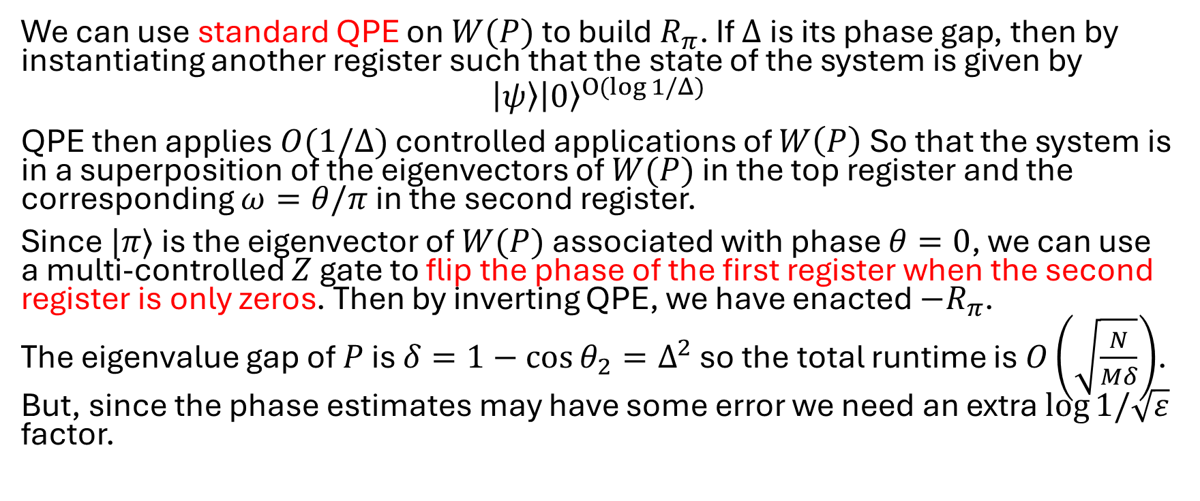
Building the diffusion operator
We can use standard QPE on $W(P)$ to build $R_{π}$. If $Δ$ is its phase gap, then by instantiating another register such that the state of the system is given by
$$\left|ψ\right\rangle {\left|0\right\rangle }^{O(log{1/Δ})}$$
QPE then applies $O(1/Δ)$ controlled applications of $W\left(P\right)$ So that the system is in a superposition of the eigenvectors of $W(P)$ in the top register and the corresponding $ω=θ/π$ in the second register.
Since $|π⟩$ is the eigenvector of $W(P)$ associated with phase $θ=0$, we can use a multi-controlled $Z$ gate to flip the phase of the first register when the second register is only zeros. Then by inverting QPE, we have enacted $−R_{π}$.
The eigenvalue gap of $P$ is $δ=1−\cos{θ_{2}}=Δ^{2}$ so the total runtime is $O\left(\sqrt{\frac{N}{Mδ}}\right)$. But, since the phase estimates may have some error we need an extra $\log{1/\sqrt{ε}}$ factor.

Slide 11
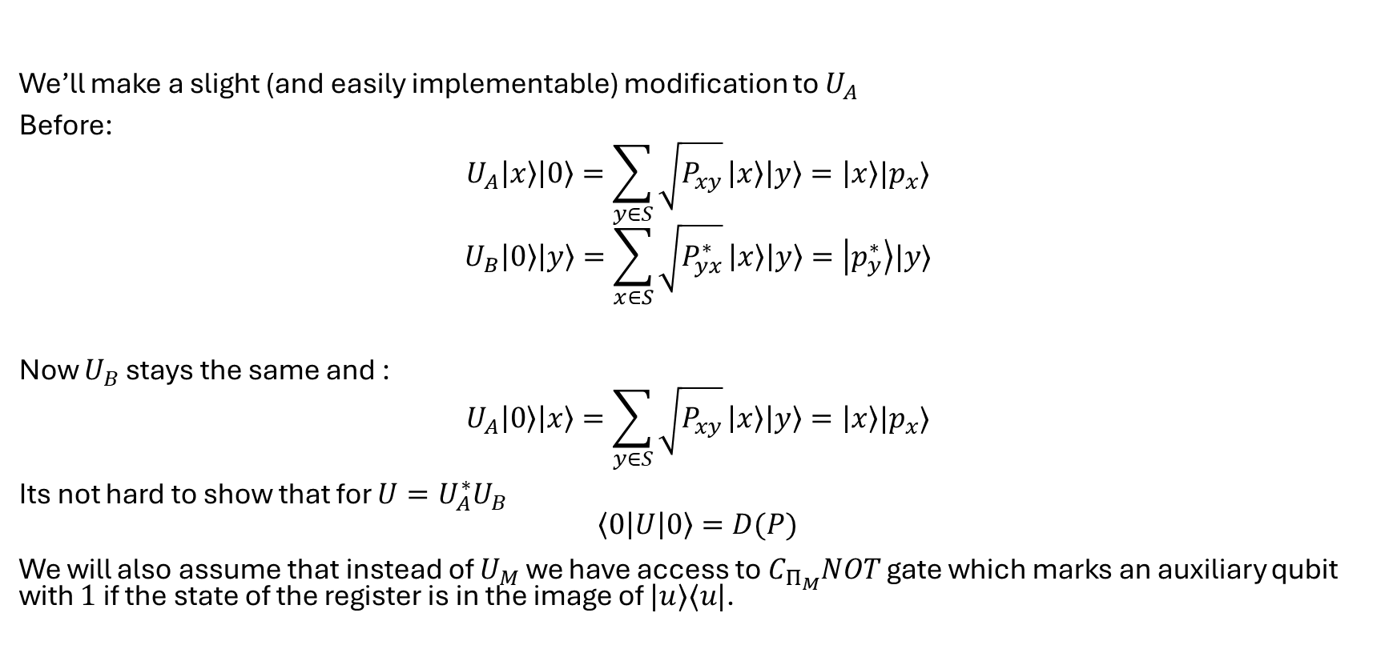
Search via QSVT: Assumptions
We’ll make a slight (and easily implementable) modification to $U_{A}$
Before:
$$U_{A}\left|x\right\rangle \left|0\right\rangle =\sum_{y∈S}{\sqrt{P_{xy}}}\left|x\right\rangle \left|y\right\rangle =\left|x\right\rangle |p_{x}⟩$$
$$U_{B}\left|0\right\rangle \left|y\right\rangle =\sum_{x∈S}{\sqrt{P_{yx}^{∗}}}\left|x\right\rangle \left|y\right\rangle =\left|p_{y}^{∗}\right\rangle |y⟩$$
Now $U_{B}$ stays the same and :
$$U_{A}\left|0\right\rangle \left|x\right\rangle =\sum_{y∈S}{\sqrt{P_{xy}}}\left|x\right\rangle \left|y\right\rangle =\left|x\right\rangle |p_{x}⟩$$
Its not hard to show that for $U=U_{A}^{∗}U_{B}$
$$\left\langle 0\left|U\right|0\right\rangle =D(P)$$
We will also assume that instead of $U_{M}$ we have access to $C_{Π_{M}}NOT$ gate which marks an auxiliary qubit with $1$ if the state of the register is in the image of $|u⟩⟨u|$.

Slide 12
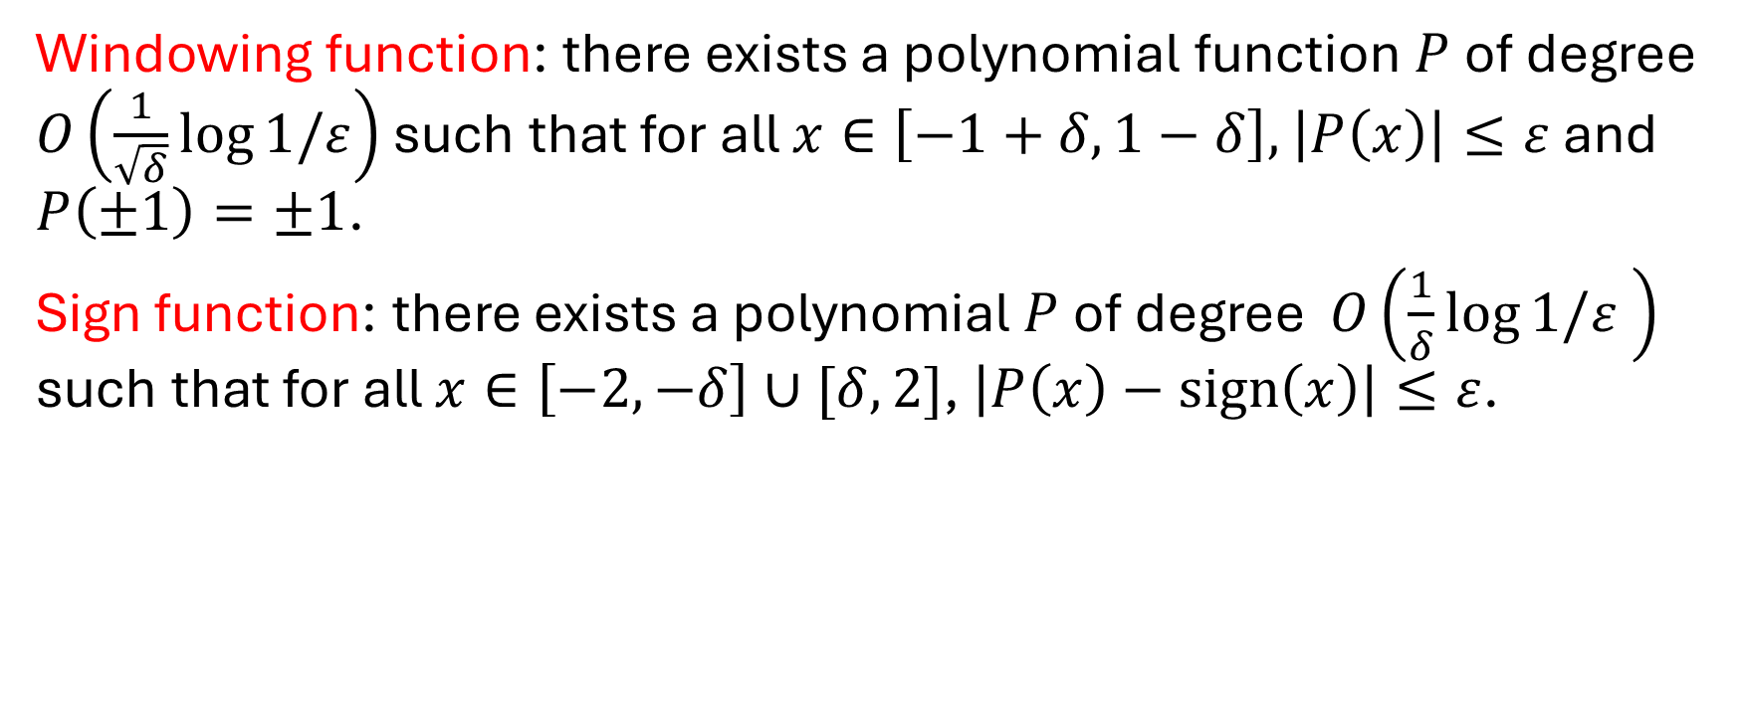
Search via QSVT: Useful Polynomials
Windowing function: there exists a polynomial function $P$ of degree $O\left(\frac{1}{\sqrt{δ}}\log{1/ε}\right)$ such that for all $x∈\left[−1+δ,1−δ\right],$ $\left|P\left(x\right)\right|≤ε$ and $P\left(±1\right)=±1$.
Sign function: there exists a polynomial $P$ of degree $O\left(\frac{1}{δ}\log{1/ε} \right)$ such that for all $x∈\left[−2,−δ\right]∪[δ,2]$, $\left|P\left(x\right)−sign\left(x\right)\right|≤ε$.

Slide 13
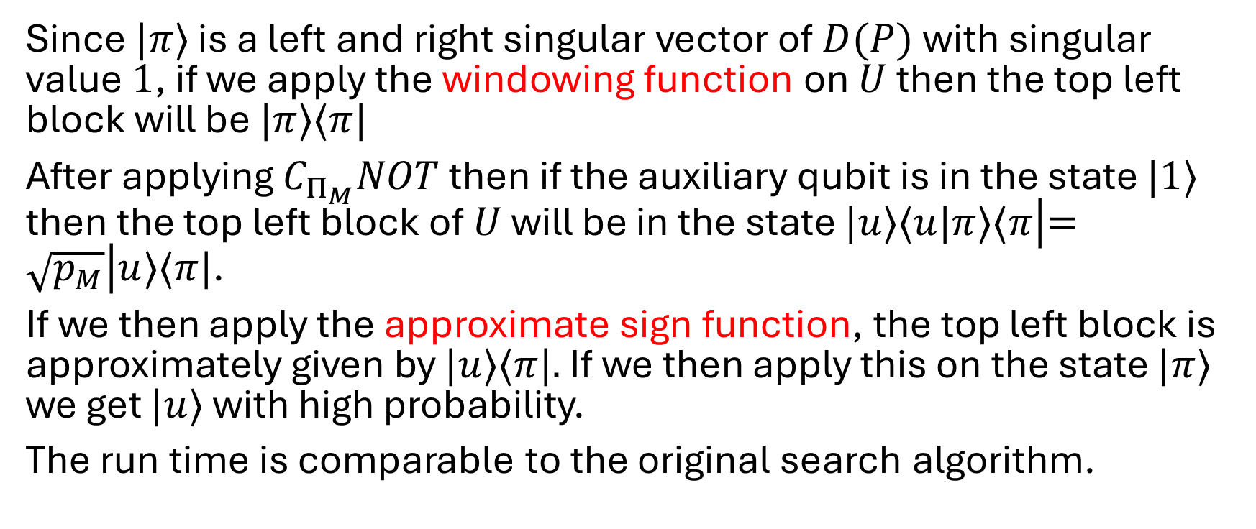
Search via QSVT: the Algorithm
Since $|π⟩$ is a left and right singular vector of $D(P)$ with singular value $1$, if we apply the windowing function on $U$ then the top left block will be $|π⟩⟨π|$
After applying $C_{Π_{M}}NOT$ then if the auxiliary qubit is in the state $|1⟩$ then the top left block of $U$ will be in the state $|u⟩⟨u|π⟩⟨π\left|=\sqrt{p_{M}}\right|u⟩⟨π|$.
If we then apply the approximate sign function, the top left block is approximately given by $|u⟩⟨π|.$ If we then apply this on the state $|π⟩$ we get $|u⟩$ with high probability.
The run time is comparable to the original search algorithm.

Slide 14
Further work
The previous algorithm does not provide a quadratic speedup in finding a marked element in a graph.
The papers
“Quantum Walks can find a Marked Element on Any Graph” (2016)
“Quadratic speedup for finding marked vertices by Quantum Walks” (2020)
“A Unified Framework of Quantum Walk Search” (2022)
All build on each other and the work presented here.

